Slide 1
DigitalOne (D1)
Sanskar Dwivedi, Software Developer

Slide 2
OC-OH
Care
D1

Slide 3
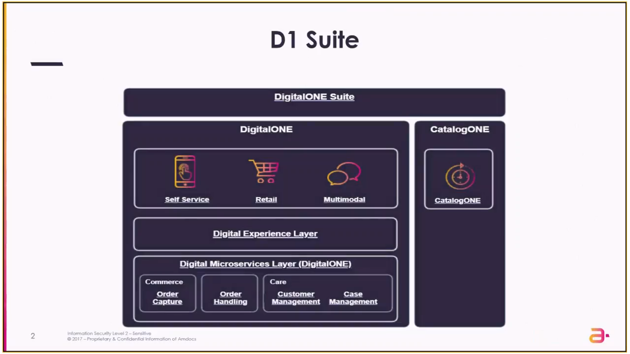
D1 Suite

Slide 4

CatalogONE
Consider it as a data source for all the product offerings in the system. Provides the capabilities to define, implement & deploy the product offerings that will be utilized by the end customer. So, these offerings become the product for the end customer.
Manages product catalog & product lifecycle.
Serves other systems for catalog data. i.e.; defines the various specifications & parameters that will be utilized by the downstream system while fulfilling any of the orders in the DigitalONE suite.
Keeps on sending incremental updates (e.g. price change) to relevant subdomains using Kafka message hub. Note: In IT, "downstream" refers to the transmission of data to an end user or toward an end user from a central server or point of origin. This contrasts with upstream transmissions, which move from the end user to the central repository.

Slide 5
DigitalONE
D1 interacts with C1 to display all the offerings to the frontend part. CatalogONE APIs are exposed, and DEX layer calls it and fetches all the offerings and displays the catalog in the frontend part. Divided into 3 layers: 1. Sales Channel/Frontend/UI Layer: These are various modes through which a customer can place an order. For example, Mobile Applications, Call Centres (via CSRs) or via Retail Stores. 2. Digital Experience Layer (DEX Layer): - DEX is an intermediate layer which has REST APIs that are exposed to the frontend part. - Provides the capability of invoking the backend API microservices of DigitalONE through the UI. - Provides the capability to design the user interface & various widgets that can be utilized on the web pages of the mobile applications. Note1: All the DigitalONE Microservices Layer APIs cannot be invoked directly by the UI; they need to go through the DEX layer to invoke them. Note2 : DEX is a stateless layer and has no database connections but only mappings to the APIs in Digital Microservices Layer.

Slide 6
DigitalONE (contd…)
3. Digital Microservices Layer (DigitalONE): Functional layer that consists of three modules- 1. Commerce (Order Capture) Responsible for creating, retrieving & submitting the order. Basically, OC domain provides all the negotiation related capabilities for any order that is placed. 2. Order Handling Once the order is submitted for ‘Order Capture’, this is the time when ‘Order Handling’ domain comes into picture. Basically, OH domain accepts & validates the incoming order and resolves it into multiple flows and invokes the actual technical flows in the orchestrator, so that all the downstream systems will get synched with the order itself and the product gets assigned or updated in the product inventory. 3. CARE Stores all the information related to the customers, the billing arrangements, the payment related information, the customer preferences(like the mode that customer prefers his/her notifications to be sent).

Slide 7
API-Led + ESB Based Architecture
UI/Frontend
Digital Experience Layer (DEX) - Experience API
Digital Microservices Layer (DML) - Process API
Enterprise Service Bus (ESB) - MiddleWare (Owned By Claro)
Ensemble Legacy Application (ENS) - System API

Slide 8
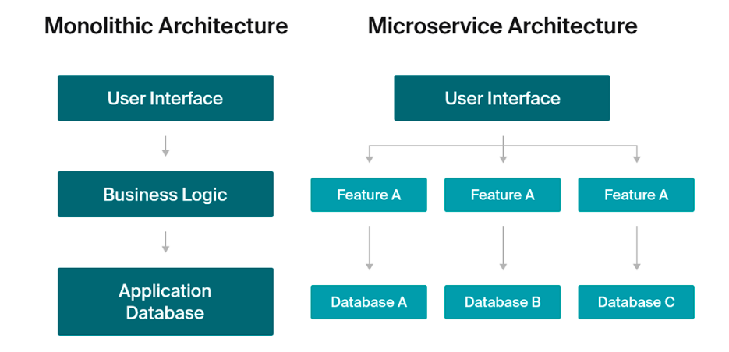
Before we proceed…
OMS was a monolith application & OC-OH is a microservices based application. Monolithic services are all-in-one applications, while microservices are standalone applications that function together in a unified manner.
OMS
(Monolith)
Order Capture
Order Handling

Slide 9
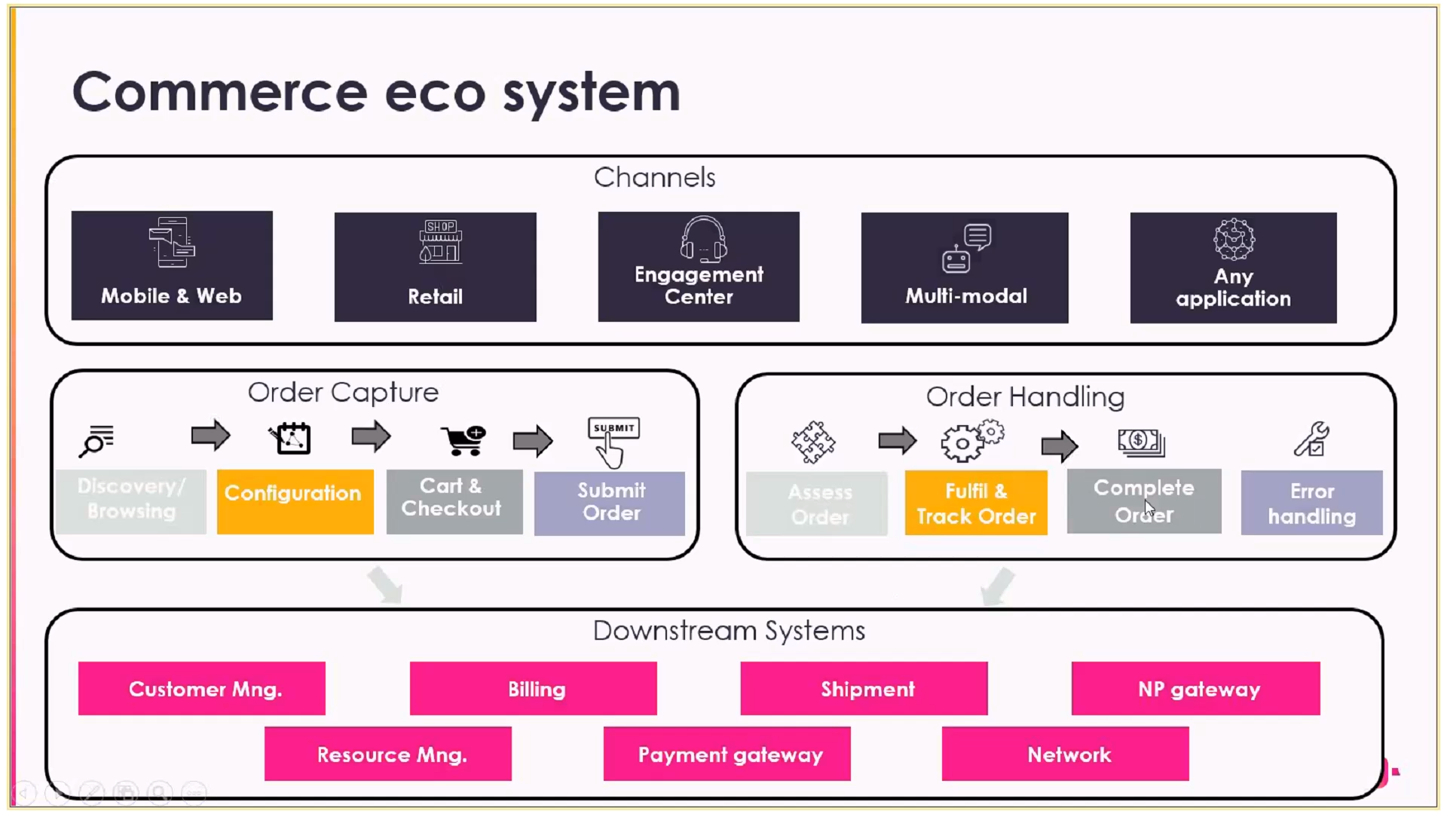

Slide 10

Order Capture-(OC)

Slide 11
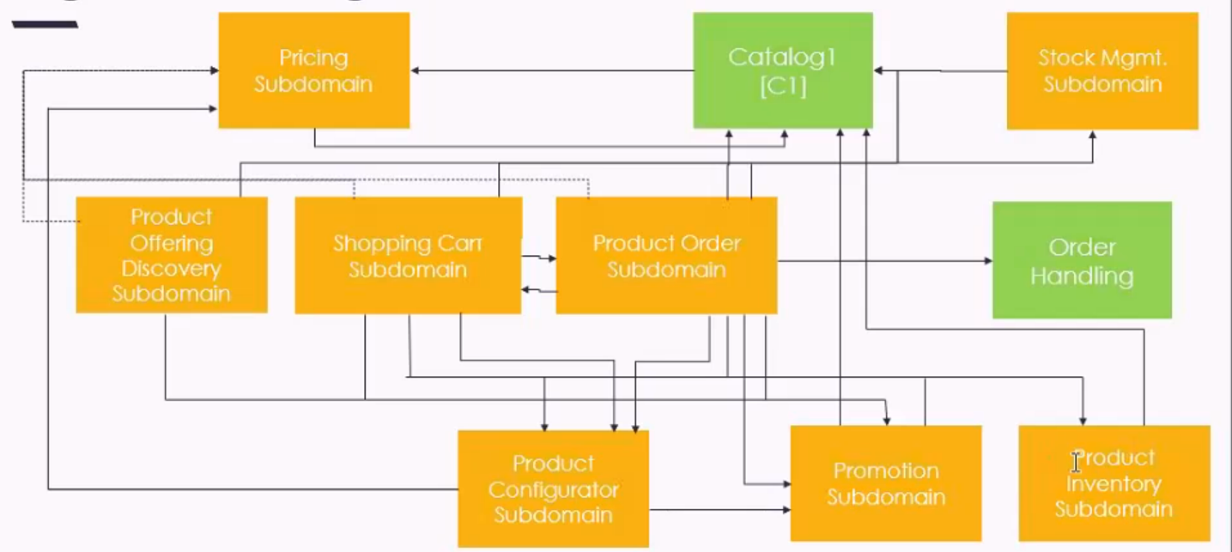
High Level View Of OC

Slide 12
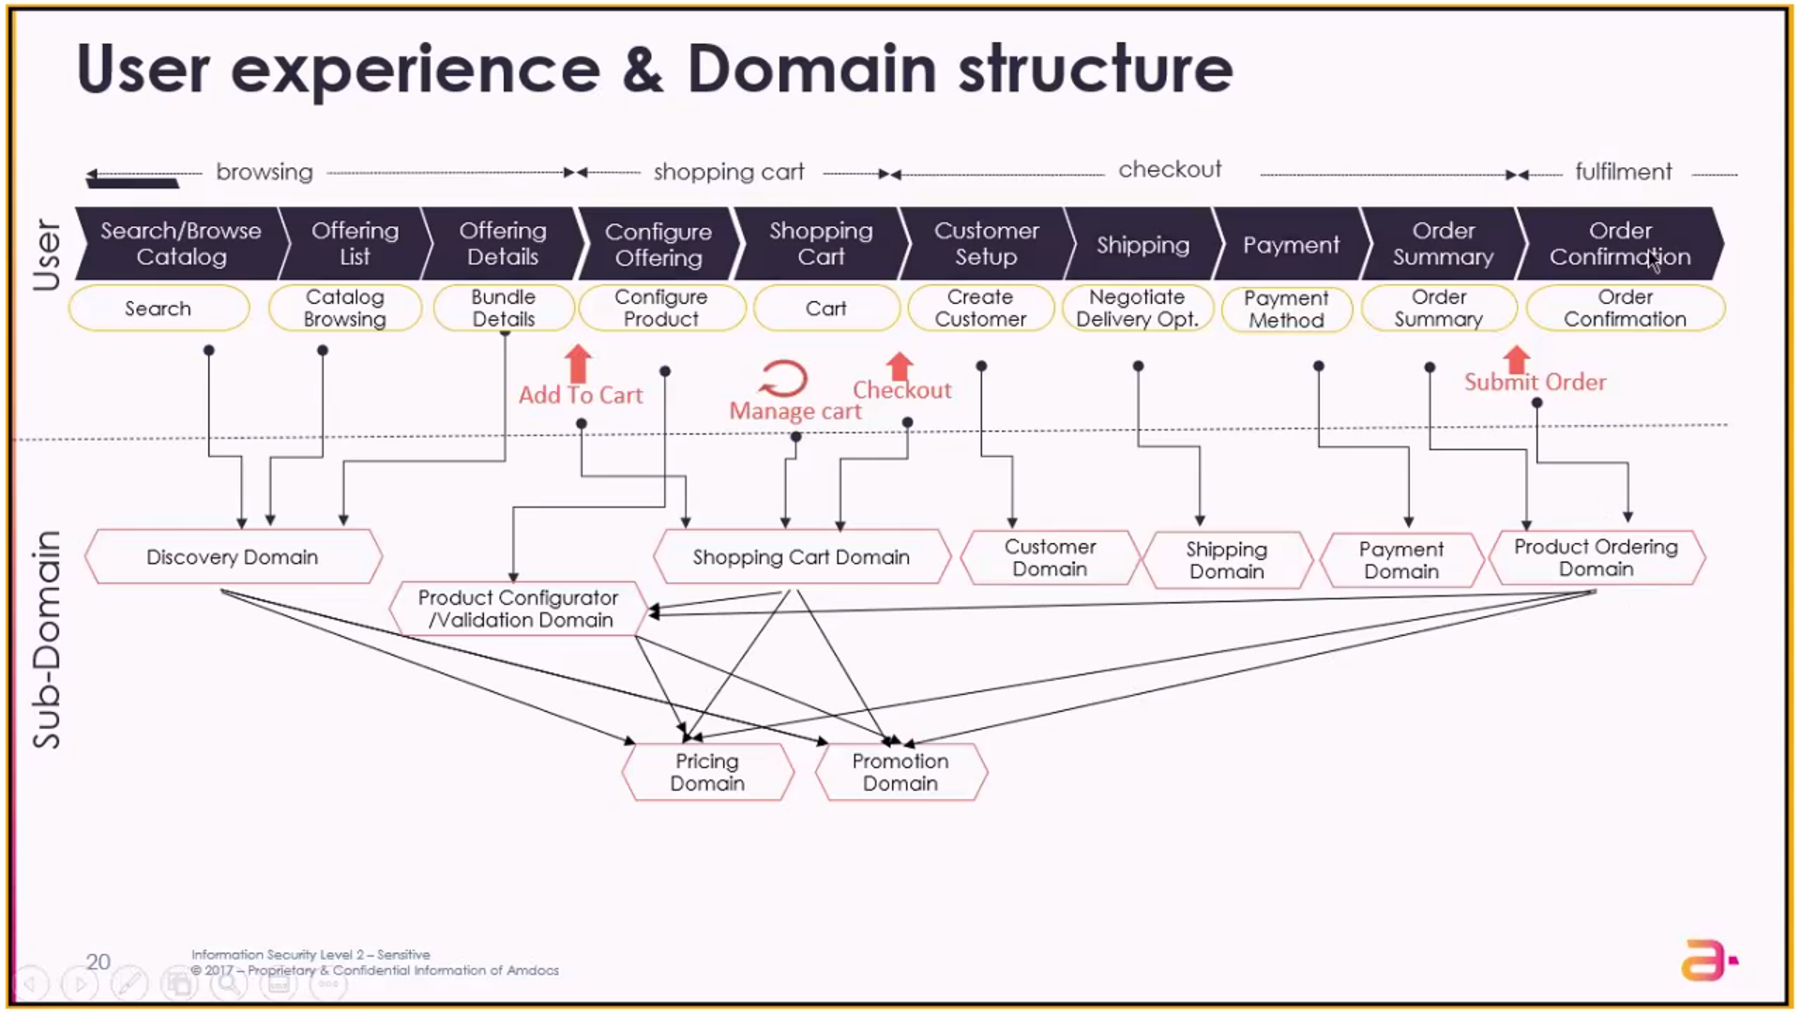

Slide 13
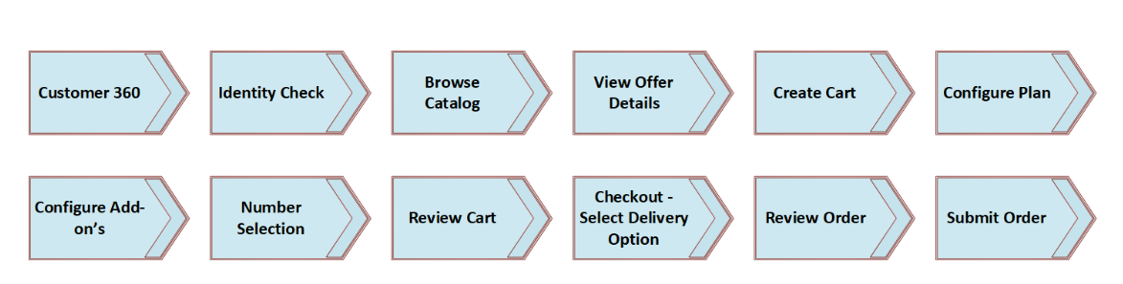
UI FLOW (Ex. Existing Customer Purchase Only Postpaid Mobile Plan)

Slide 14
Order Capture Subdomains (12)
Appointment Management
Number Portability Management
Price Calculation
Product Configurator
Product Inventory Management
Product Offering Discovery
Product Ordering Management
Promotion
Resource Inventory Management
Service Qualification Management
Shopping Cart
Stock Management

Slide 15
Appointment Management Subdomain
A façade that integrates with the external Workforce Management system which is the primary system for managing the appointments.
Note1: This is only a simulator for the Appointment Management system interface. Note2: The facade pattern is a software-design pattern commonly used in object-oriented programming. Analogous to a facade in architecture, a facade is an object that serves as a front-facing interface masking more complex underlying or structural code.
For each appointment, relevant information about the appointment is transferred to the Workforce Management system, such as the date, time, and address of the appointment.
Upon creation of an appointment in the Workforce Management system, a reference is provided to the Appointment Management subdomain.
In addition, the Appointment Management subdomain enables retrieving, updating, and deleting an appointment in the Workforce Management system.

Slide 16
Number Portability Management: Port In
The Number Portability subdomain is a facade that integrates with third-party systems for retaining a resource number when the customer is moving between service providers.
Port In
The Number Portability subdomain capabilities are invoked during order execution:
- In the order capture phase, when there is a request to port-in a number, validation is performed to ensure that number portability can be performed.
- During the order fulfillment phase, the telephone number is being moved from the donor to the target service provider.
- After a number portability request is created at the donor service provider, the target service provider is responsible to take decisions according to the status that is returned from the donor service provider.
- The Number Portability subdomain enables different operations when integrating with the third-party system (donor service provider), as follows:
Validating that the port-in request is permitted
Creating the port-in request at the donor service provider system
Updating the port-in request at the donor service provider system
Reporting of the status of the port-in request to the target service provider

Slide 17
Number Portability Management: Port Out
A request to port out a number is received from an external consumer. The Number Portability subdomain is responsible for:
Validating the request
Creating a port-out request, including:
Creating a product order
Submitting the product order
Receiving a notification from Amdocs Order Management that the port-out process is completed
Notifying the consumer that their request to port out a number is completed successfully

Slide 18
Price Calculation
Provides a standardized mechanism with which to calculate the prices of product offerings according to the price definition in Amdocs Catalog.
The output includes one-time and recurring prices (full-period and prorated), related taxes, and totals. Note: Proration refers to a subscription payment that has been amended based on the actual usage. This means that the user only pays for what they used rather than for the whole billing period.
The subdomain returns prices and totals for any specific configuration that is requested in the capability context, such as Product Offering Discovery, Shopping Cart, and Product Ordering.
The subdomain can integrate with an external price engine.
The calculated price information includes:
Price information such as name, description, and type
Price amounts, including fees, tax, and totals
Installment options, including down-payment, if required, and the number of installments
Immediate payment indicator which defines whether the charge must be paid immediately or can be paid on bill day.

Slide 19


Product Configurator
Provides a standardized mechanism to configure and validate a product offering.
This subdomain returns the:
Existing product configuration, along with the available configuration options that can be added or removed.
Available values of configurable product specification characteristics and product offering level characteristics
The product configurator enables performing changes on negotiated product offerings, provides a final price, and then validates the product offering according to technical and commercial rules and policies, such as dependencies, conditional selection, and so on.

Slide 20
Product Inventory Management
Acts as a repository for product inventory items assigned to the customer. It is used to persist the data of ordered product inventory items.
The Product entity in Product Inventory Management represents an ordered product offering item with a reference to its catalog definition. When an order arrives to Product Inventory Management, the Product Inventory creates a Product entity for each service included in the order. Each product inventory item maintains a reference to the order or order item information, price and promotion information, customer information and relations between inventory products. For example, when an order for a multi-play bundle arrives to Product Inventory Management, the Product Inventory creates a separate Product entity for the multi-play bundle as well as all of its inner products.
The product status is based on the status in the order. If it is not specified, Product Inventory Management calculates it via the Product Configurator subdomain.
The Product Inventory Management subdomain enables consumers to maintain a history of product inventory versions owned by their customers. The Product Inventory Management subdomain provides a set of capabilities used by consumers, such as retrieving customer inventory product details and updating existing product inventory (by submitting modification orders such as modify, suspend, resume, and terminate orders).
Prior to persisting the data, Product Inventory Management performs a range of activities that validate the Product Inventory, such as validating product configurations, validating whether a product can transition to its next product status, validating the existence of a customer in Amdocs Care, and validating the existence of a paying entity.

Slide 21
Product Offering Discovery
The Product Offering Discovery subdomain enables searching for product offerings across different sales channels and finding a suitable product offering.
This subdomain is using the information from Amdocs Catalog according to the default configuration that is defined there (such as sellable product offerings as either a device or a bundle product offering, categories, discoverable characteristics, prices, promotions) for the following capabilities:
Retrieving the list of product offerings
Searching for product offerings according to several search criteria
Filtering product offering list according to filterable information
Sorting product offering list according to predefined sort criteria
Comparing between product offerings
Retrieving the details of a specific product offering
Retrieving the list of replaceable product offerings for a specific product offering
The information from Amdocs Catalog is cached in a dedicated discovery repository (using indexing), to optimize speed and performance when performing different search operations.

Slide 22
Product Ordering Management
Provides a standardized mechanism for placing a product order with the necessary product order parameters.
A product order references the product offering and identifies any specific requests made by the customer. The product order can include one or more order items, where each item represents a product offering that is defined in Amdocs Catalog. An order item can represent a new product offering or a modification to an existing assigned product inventory.
Capabilities of this subdomain include product configuration, exposing prices and totals, and capturing additional information such as payment and delivery details, prior to submitting the order to fulfillment.
Both product order and order item consist of several configurable states that change according to predefined actions.

Slide 23

Promotions
Responsible for the qualification of promotions including qualification conditions and promotion benefits.
Provides a standardized mechanism for real-time communication of promotions to customers throughout the Amdocs Commerce journey. This journey begins at discovery, continues to cart and configuration, and is finalized at the order submission. In this journey, each subdomain invokes the Promotion subdomain and receives the qualified promotions for the product offering in context. Based on the qualified promotions, each subdomain calculates the final price and provides discounts based on the product offering.
Promotions are defined and managed as Amdocs Catalog entities.
Note: Promotions are benefits offered by the service provider for a specified period of time with the purpose of attracting new customers and increasing the customers purchases. Promotions provide an incentive for customers to purchase new product offerings or to expand their services and purchases. Promotions can have a wide range of marketing objectives, including sales increases, new product or service acceptance, positioning, and customer preservation. Promotions are provisioned on top of the existing catalog product offerings without having to modify the existing product offerings.

Slide 24

Resource Inventory Management
Is a façade that integrates with the external Resource Management system according to the specific implementation.
Enables different operations required on logical resources (such as IP Address and MSISDN), which are allocated to the service provider by external systems. The different operations on the resource include reserving or releasing a resource during the purchase, or the modification flow for the logical resources. In the case of Number Portability, the façade provides an operation to create a new logical resource (port-in). This subdomain defines an interface the must be implemented by each project.
The façade of the Resource Inventory Management subdomain needs to be configured according to the business logic of the integrated Resource Management system (such as using the lifecycle states of logical resources that are implemented in the Resource Management system).

Slide 25
Service Qualification
A façade that integrates with an external third-party system & enables retrieving serviceability information, in order to check which product offerings and characteristic values are serviceable for a given location, such as, region, zip code, and address.
Returns the relevant serviceability information supported at the provided location, such as technology and speeds. This information is cached for a configurable time frame. When the information does not exist in the cache, the Service Qualification subdomain invokes a call to the external third-party system. Currently, the core serviceability capability is configured to support the technology and speed information.
Based on the information returned by the Service Qualification subdomain, Amdocs Catalog and some of the Amdocs Commerce subdomains (such as Product Offering Discovery and Product Configurator) are able to:
Filter serviceable products offering
Validate if the selected product offering is still valid when the user updates his location or changes the product offering configuration.
Based on the configuration parameter, the Amdocs Commerce subdomains are able to invoke a serviceability check in any stage (such as add cart item, cart check out, add order item) of the ordering process.
However, during the submit operation in the Product Ordering subdomain, a serviceability check is mandatory.

Slide 26

Shopping Cart
Provides a standardized mechanism for the management of shopping carts, including creation, update, retrieval, validation, and checkout.
The shopping cart entity is used for the temporary selection and reservation of product offerings during the ordering flow as well as during the update of products owned by customers.
The shopping cart includes one or more cart items that correspond to both tangible and intangible goods and services, such as a mobile device, family plan, and Internet plan.
The shopping cart contains the following details :
A list of cart items
A reference to the customer (partyRole) or to a contact medium if the customer does not exist
The total price of all items, including promotions

Slide 27
Stock Management
Includes a façade that integrates with an external third-party system and provides a mechanism to manage stock availability for product offerings that are sold to the customers: retrieve stock levels (quantity per product type), reserve stock items, release a stock reservation and update the stock level.
The stock level will be cached for a configured time frame. When the information does not exist in the cache, the Stock Management subdomain will invoke a call to the external third-party system. This information enables the Amdocs Commerce subdomains to retrieve stock levels and the quantity of the product offerings, and to validate that the selected product offerings are available in stock.
Only tangible goods, such as Devices or Headphones are part of this stock availability. Other products, such as Plan or Data Allowance, are not bound to stock availability (based on the Amdocs Catalog definition).
The Amdocs Commerce subdomains define, by means of a configurable parameter, whether to invoke a call to stock management or not.

Slide 28

Order Handling-(OH)

Slide 29
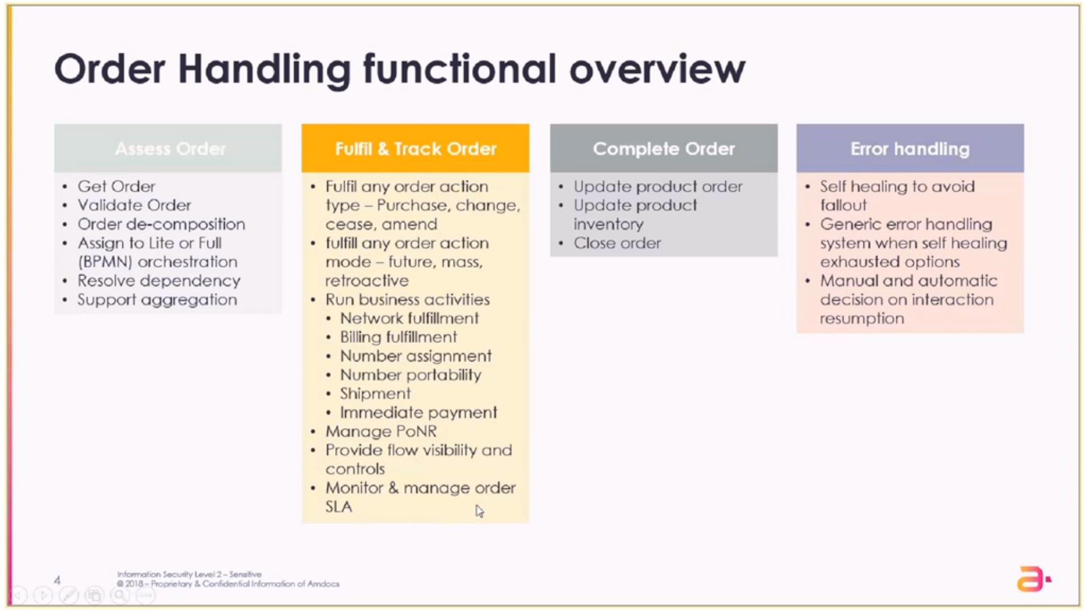

Slide 30
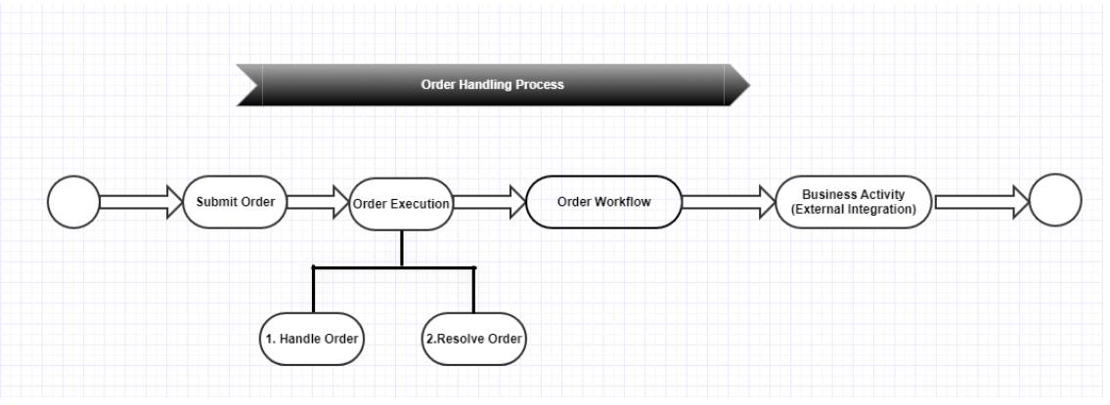

Once we submit the order , Order handling process is triggered in the system.
Submit order → Order Execution Subdomain (Handle Order MS- Core)→ Validate Order → Resolver (Resolves the order by deciding which flow to execute/ Which BPMN to run)
For all Business steps executed by Camunda we have a common contract to be used in all microservices - step integration pattern: each MS will always receive a flow context object and return a flow context object.

Slide 31
Camunda Ecosystem
- Components Introduction Camunda Platform is used mainly for Architecture. It is a lightweight, Java-based framework. It can be used as a standalone process engine server or embedded inside custom Java applications. It offers non-Java developers a REST API and dedicated client libraries to build applications connecting to a remote workflow engine. The are 3 main applications in Camunda:
1. Cockpit - to manage and monitor all existing processes (BPMN's) *Mainly what we need to use to test and monitor our OH processes 2. Designer- to design the flows 3. Admin - to manage users
- Camunda BPM (Business Process Modeling) Engine: It provides a Business Process Model and Notation (BPMN) standard compliant workflow engine and a Decision Model and Notation (DMN) standard compliant decision engine, which can be embedded in Java applications and with other languages via REST.

Slide 32
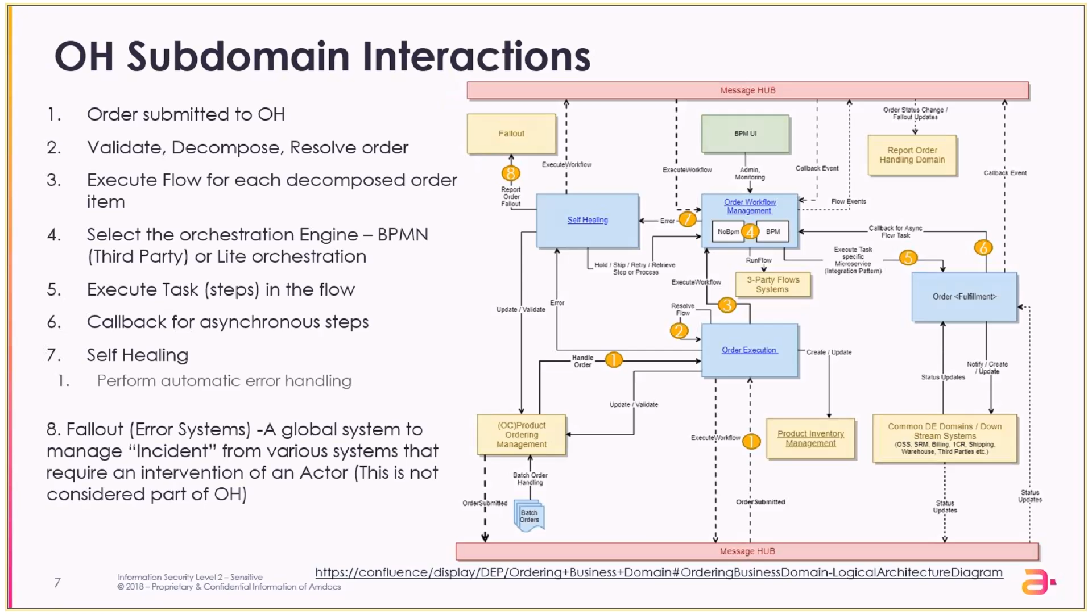

Slide 33
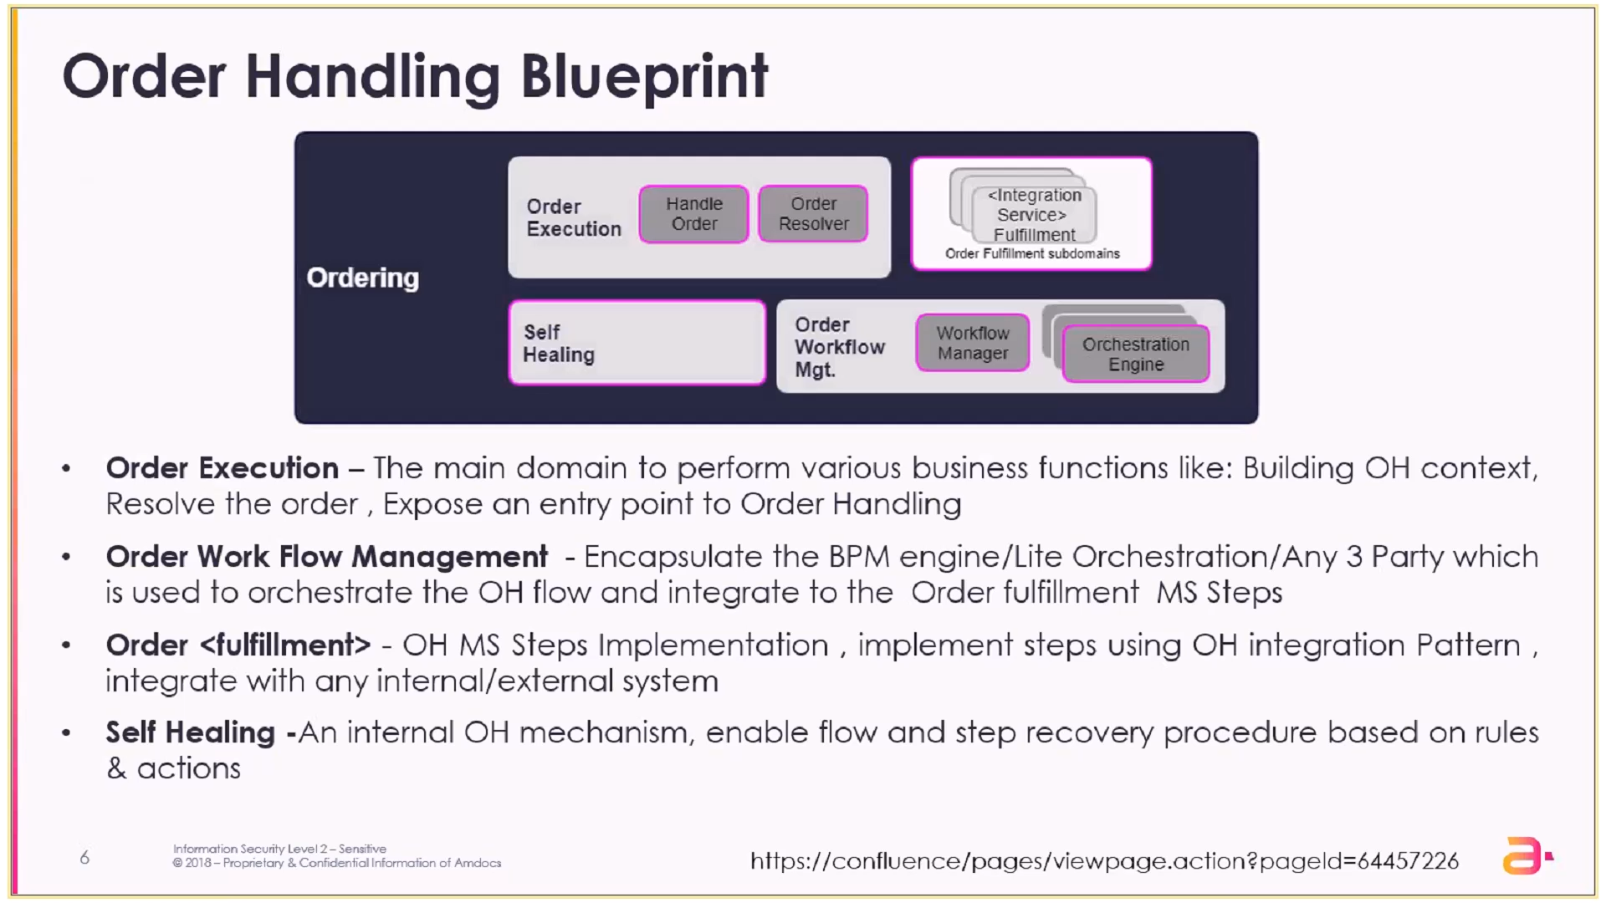

Slide 34
Order Handling Subdomains (6)
Order Execution
Order Workflow Management
Business Activity
Self Healing
Shipping Order Management
Fallout Management

Slide 35
Order Execution
Acts as an entry point for an order in the Order Handling system.
Orders from different sales channels (such as self-service, retail, and call center) are captured by any Order Capture system and submitted to Order Handling system for further processing.
Houses a critical component having a strategy-based implementation for resolving multiple scenarios for an incoming order, which are then evaluated at runtime of the flow. Note: Strategy pattern enables a client code to choose from a family of related but different algorithms and gives it a simple way to choose any of the algorithm in runtime depending on the client context.
Analyzes various parameters of an order in context and provides enablement of steps accordingly.

Slide 36
Order Workflow Management
Enables construction, execution, and monitoring of the order fulfillment flow.
Enables the business implementor to construct an end-to-end business process for the fulfillment of order items.
Hosts a third-party Business Process Management (BPM) engine that provides an orchestration framework to run and monitor the order fulfillment flow. The BPM Engine complies with BPMN 2.0 standard.
This subdomain provides: - A dependency framework that orchestrates flow- and step-level dependencies across flows. - An aggregation framework that orchestrates step-level aggregation across all associated flows.
- The error handling and Self Healing framework of this subdomain provides the routing of flow- or step-level errors to Self Healing subdomain and various inbuilt automatic resolutions, such as Retry, Ignore, and Wait. This subdomain enables upstream applications, such as Order Capture, to check for PONR, pause a flow, or release hold for a paused flow. This subdomain also enables the Fallout Management system to retry the failed flow.

Slide 37
Business Activity
The Business Activity is a façade subdomain that provides a set of functions that execute the order activities while interacting with the relevant downstream systems.
The orchestrator activates these functions by calling each of the relevant downstream systems through a series of sequential steps in the order fulfillment flow.
This subdomain is pre-integrated with various other digital subdomains of DigitalONE and RevenueONE, such as Resource Inventory subdomain, Customer Billing subdomain.

Slide 38
Self Healing
The Self Healing subdomain is responsible for managing and resolving known errors automatically.
This way, Self Healing helps reduce the time to market and manual handling load in Fallout.
The Self Healing subdomain integrates with the DigitalONE rule engine to enable various resolution rules and actions for system errors.
Self Healing also acts as a gateway to the Fallout Management system in case manual intervention is required.

Slide 39
Shipping Order Management
Provides the ability to integrate with any third-party logistics system to create and receive updates about the shipment of the orders.
Persists the shipment data and tracks the end-to-end Shipment Lifecycle.
Manages the shipping request received from the Business Activity subdomain along with the shipping details needed for shipment. The information includes the products to be shipped, the recipient details, address details, and shipping details.
Note: A Third-Party Logistics system is currently a simulator implementation. Customization teams are responsible for the implementation of any additional functionality, if required.

Slide 40
Fallout Management
The Fallout Management subdomain is a shared subdomain.
It is responsible for receiving errors as fallout events and relaying the reported errors to the Fallout system.
This subdomain is pre-integrated with the Fallout system and provides a generic implementation for any subdomain or upstream application to integrate with this subdomain to create fallout events for manual handling.

